Slide 1



UX Components

Slide 2
Agenda
Reusable IP and content from the particular scenario
Building blocks for UX Components
Page manipulation
Web part and app part manipulation
Client side rendering
Showing apps and data in dialogs
Personalized UI elements
Data aggregation and caching

Slide 3
Page manipulation

Slide 4

Introduction wiki page modification
What
Modify content in wiki pages (site pages library) from SP App by adding html elements or additional web parts.
Why
Modify end user experience automatically on the host web when app is installed or when the sites are provisioned.
How
Access host web using CSOM and add needed html or modify the web parts in the page.

Slide 5
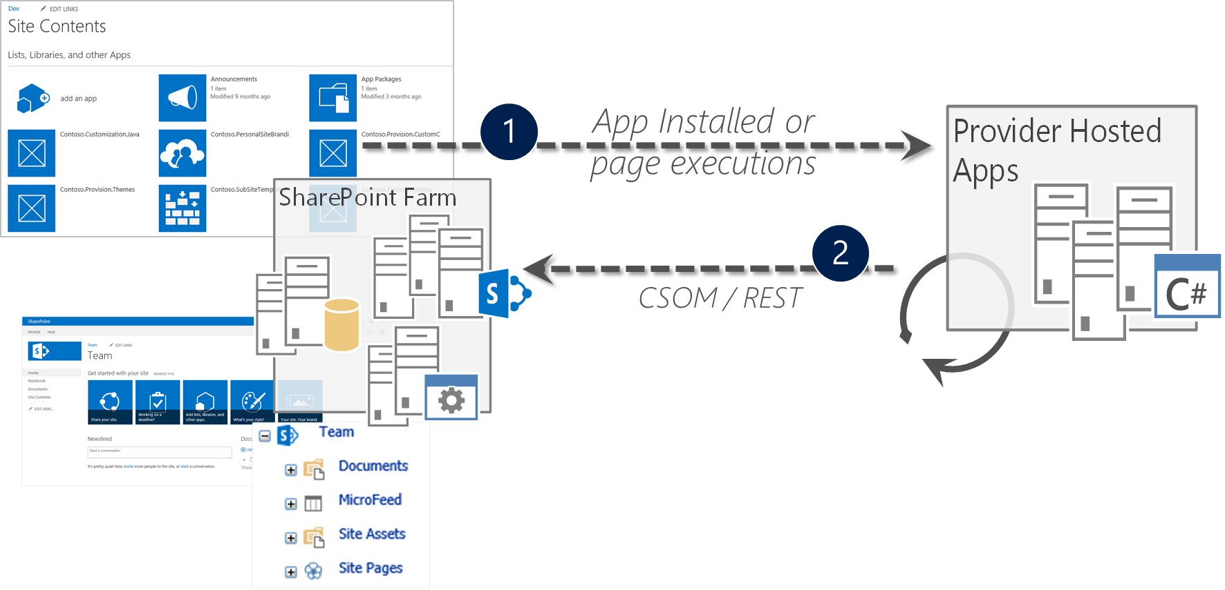
Modify host web content
Handle App Installed event in provider hosted app
Access host web using client side object model to modify the end user experience

Slide 6
Add wiki page to host web
Web web = site.RootWeb;
var pageLibrary = web.Lists.GetByTitle(“Site Pages”);
ctx.Load(pageLibrary.RootFolder, f => f.ServerRelativeUrl);
ctx.ExecuteQuery();
var pageLibraryUrl = pageLibrary.RootFolder.ServerRelativeUrl;
var newWikiPageUrl = pageLibraryUrl + "/" + wikiPageName;
var currentPageFile = web.GetFileByServerRelativeUrl(newWikiPageUrl);
ctx.Load(currentPageFile, f => f.Exists);
ctx.ExecuteQuery();
if (!currentPageFile.Exists)
{
var newpage = pageLibrary.RootFolder.Files.AddTemplateFile(newWikiPageUrl, TemplateFileType.WikiPage);
ctx.Load(newpage);
ctx.ExecuteQuery();
wikiPageUrl = String.Format("sitepages/{0}", wikiPageName);
}

Slide 7
Page Manipulation
Demo

Slide 8
Web part and app part manipulation

Slide 9
Extending OOB web parts
What
Rather than implementing custom web parts, provide pre-define out of the box templates which have needed branding and capabilities included
Why
Provides fast and cost efficient way to introduce reusable templates to avoid need of web parts or web parts
How
Configure OOB web parts, export and use them in web part gallery for other sites
Notes:
Title: Extending oob web parts
Time: 1 minute
What
Rather than implementing custom web parts, provide pre-define out of the box templates which have needed branding and capabilities included
Why
Provides fast and cost efficient way to introduce reusable templates to avoid need of web parts or web parts
How
Configure out of the box web parts, export and use them in web part gallery for other sites

Slide 10

Steps to bring new templates to sites
Add OOB web part to page with desired configuration
Export .webpart file from page
Add .webpart file to web part gallery with specific attributes
Start using pre-defined templates
Note: .webpart files can be added to the site automatically from SP App to web part gallery for enabling new capabilities in host web

Slide 11
Web part and app part manipulation
Demo

Slide 12
Client side rendering

Slide 13
IP coming
Work in progress

Slide 14
Client side rendering
Demo

Slide 15
Showing apps and data in dialogs

Slide 16
IP coming
Work in progress

Slide 17
Showing apps and data in dialogs
Demo

Slide 18
Personalized UI elements

Slide 19
Social CSOM - Introduction
Provides access to following capabilities
User profile access
Reading of profile properties
Change user profile picture
Only reading is supported, no update capabilities for user profile
Can be used from .NET applications or from JavaScript
.NET - Microsoft.SharePoint.Client.UserProfiles.dll
REST - http://<siteUri>/_api/SP.UserProfiles.PeopleManager
JavaScript - SP.UserProfiles.js
Notes:
SharePoint 2013 includes new Social CSOM API, which can be used to provision the personal my site or also to access the personal my site remotely, which is actually the key for changing the branding elements in the site. By using this API set, you can built a pretty simple provider hosted application, which will actually modify personal sites or SkyDrive Pro experience based on company branding. After code has been written, it’s just ensuring that it’s executed for the users properly, by placing app part to for example public my site host page or just as well you could place the same app part to front page of the intranet, to ensure that branding is applied or updated when end users access the SharePoint.
For more information check out my blog post on MSDN: Customizing SharePoint 2013 personal sites using SP Apps with remote provisioning:
http://blogs.msdn.com/b/vesku/archive/2013/08/29/customizing-sharepoint-2013-personal-sites-using-sp-apps-with-remote-provisioning.aspxe

Slide 20
Getting all user profile properties
// Replace the following placeholder values with the target SharePoint site and target user.
const string serverUrl = "http://serverName/";
const string targetUser = "domainName\\userName";
// Connect to the client context.
ClientContext clientContext = new ClientContext(serverUrl);
// Get the PeopleManager object and then get the target user's properties.
PeopleManager peopleManager = new PeopleManager(clientContext);
PersonProperties personProperties = peopleManager.GetPropertiesFor(targetUser);
// Load the request and run it on the server.
clientContext.Load(personProperties, p => p.AccountName, p => p.UserProfileProperties);
clientContext.ExecuteQuery();
foreach (var property in personProperties.UserProfileProperties)
{
Console.WriteLine(string.Format("{0}: {1}", property.Key.ToString(), property.Value.ToString()));
}

Slide 21
Retrieve specific user profile properties
// Replace the following placeholder values with the target SharePoint site and the target user.
const string serverUrl = "http://serverName/";
const string targetUser = "domainName\\userName";
// Connect to the client context and get PeopleManager object
ClientContext clientContext = new ClientContext(serverUrl);
PeopleManager peopleManager = new PeopleManager(clientContext);
// Retrieve specific properties by using the GetUserProfilePropertiesFor method.
string[] profilePropertyNames = new string[] { "PreferredName", "Department", "Title" };
UserProfilePropertiesForUser profilePropertiesForUser = new UserProfilePropertiesForUser(clientContext, targetUser, profilePropertyNames);
IEnumerable<string> profilePropertyValues = peopleManager.GetUserProfilePropertiesFor(profilePropertiesForUser);
// Load the request and run it on the server.
clientContext.Load(profilePropertiesForUser);
clientContext.ExecuteQuery();
// Iterate through the property values.
foreach (var value in profilePropertyValues)
{
Console.Write(value + "\n");
}

Slide 22
What about other social CSOM capabilities?
Social CSOM also supports SharePoint news feed manipulations which can be useful unless Yammer is used

Slide 23
Personalized UI elements
Demo

Slide 24
Data aggregation and caching

Slide 25
IP coming
Work in progress

Slide 26
Work in progress
Data aggregation and caching
Demo

Slide 27


© 2014 Microsoft Corporation. All rights reserved. Microsoft, Windows, and other product names are or may be registered trademarks and/or trademarks in the U.S. and/or other countries.
The information herein is for informational purposes only and represents the current view of Microsoft Corporation as of the date of this presentation. Because Microsoft must respond to changing market conditions, it should not be interpreted to be a commitment on the part of Microsoft, and Microsoft cannot guarantee the accuracy of any information provided after the date of this presentation. MICROSOFT MAKES NO WARRANTIES, EXPRESS, IMPLIED OR STATUTORY, AS TO THE INFORMATION IN THIS PRESENTATION.

